Slide 1
Kaggle Projects
Quora Insincere Questions Classification
H&M Personalized Fashion Recommendation

Slide 2
Outline
Quora Insincere Questions Classification
Introduction
Data
Exploration and Visualization
Preprocessing
Modelling
Evaluation and Results
Additional Work
H&M Personalized Fashion Recommendations
Introduction
Data
Exploration and Visualization
Preprocessing
Calculating Similarity
Results
Future Work

Slide 3
Quora Insincere Questions Classification

Slide 4
Introduction

Slide 5
What is Quora?
Quora is a platform that empowers people to learn from each other
On Quora, people can ask questions and connect with others who contribute unique insights and quality answers

Slide 6
Problem Statement
A key challenge is to weed out insincere questions -- those founded upon false premises, or that intend to make a statement rather than look for helpful answers
The aim of this project is to develop a model that identify and flag insincere questions

Slide 7
What are Insincere Questions?
Insincere question is defined as a question intended to make a statement rather than look for helpful answers
Characteristics of an Insincere Question
Has a non-neutral tone
Is disparaging or inflammatory
Isn't grounded in reality
Uses sexual content for shock value

Slide 8
Data

Slide 9
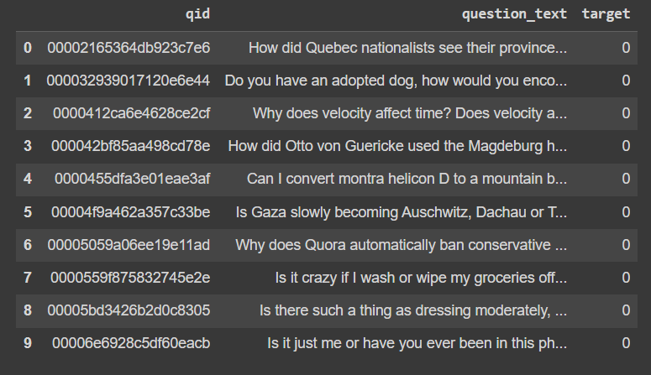
Data
The training file contains the following data fields:
qid - unique question identifier
question_text - Quora question text
target - a question labeled "insincere" has a value of 1, otherwise 0

Slide 10
Exploration and Visualization

Slide 11
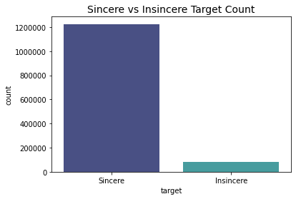
While exploring the data, I found out the questions distribution was highly imbalanced!

Slide 12
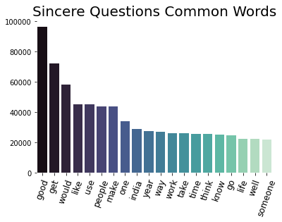
Top occurring keywords in Sincere Questions

Slide 13
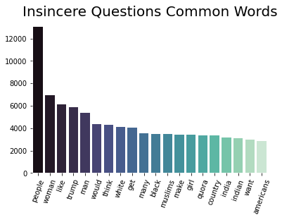
Top occurring keywords in Insincere Questions

Slide 14
Preprocessing

Slide 15
Preprocessing Steps
Initially embeddings existed for only 33.16% of the vocabulary, after preprocessing it increased to 74.24%
Loaded pre-trained Glove embeddings Common Crawl (840B tokens, 2.2M vocab, cased, 300d vectors)
GloVe is an unsupervised learning algorithm for obtaining vector representations for words
Checked the vocab which exists in the embeddings
Notes:
Try using edit distance for minimizing the number of errors

Slide 16
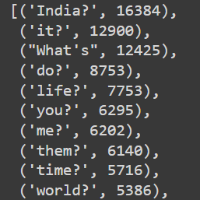
Preprocessing Steps
Incorporated vocabulary not existing in embedding using different pre-processing techniques like
Removing punctuations,
Removing non-english words
Replacing multiple empty spaces with a single empty space
Words not present in the embeddings

Slide 17
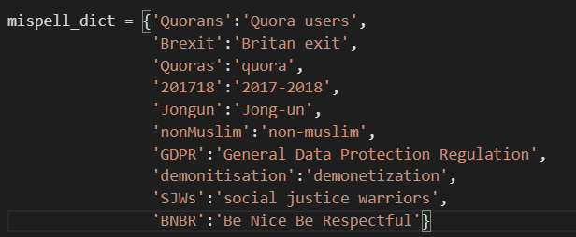
Preprocessing Steps
Created a misspelled dictionary for incorporating words like
Joined words
Acronyms
Frequently misspelled words
Misspelled Dictionary

Slide 18
Bi-directional LSTM Model

Slide 19
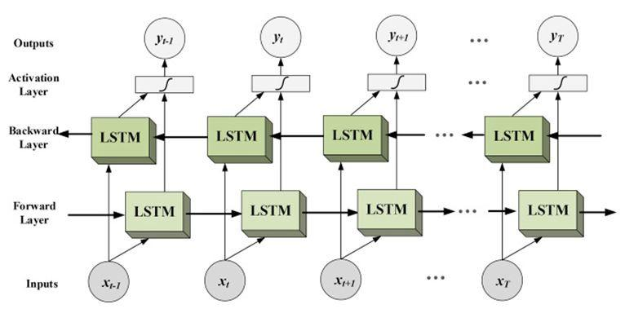
Bi-Directional LSTM Model
Notes:
Bidirectional long-short term memory(bi-lstm) is the process of making any neural network o have the sequence information in both directions backwards (future to past) or forward(past to future). In bidirectional, our input flows in two directions, making a bi-lstm different from the regular LSTM.

Slide 20
Hyperparameter Optimization
For hyperparameter optimization, I used ReduceLRonPlateau, so it reduces the learning rate when a metric has stopped improving.

Slide 21
Evaluation and Results

Slide 22
Evaluation Metric
Imbalanced classes are a common problem in machine learning classification where there are a disproportionate ratio of observations in each class
I used the F1 score which balances precision and recall.
Precision is the number of true positives divided by all positive predictions. Low precision indicates a high number of false positives.
Recall is the number of true positives divided by the number of positive values in the test data.. Low recall indicates a high number of false negatives.

Slide 23
Results
I got an F-1 score of 0.6705 with the Bi-directional LSTM model.

Slide 24
Additional Work

Slide 25
What other approaches did I try?
Other than the results I tried to implement BERT through Tensorflow and Pytorch both
Notes:
Due to version error, I couldn’t run the tensorflow version
Also to get some hands-on experience with Pytorch I tried to implement BERT with Pytorch as well. It is very heavy computationally, so couldn't get any results even after 48 hours.

Slide 26
Questions?

Slide 27
H&M Personalized Fashion Recommendations

Slide 28
Introduction

Slide 29
Introduction
H&M Group is a family of brands and businesses with 53 online markets and approximately 4,850 stores.
But with too many choices, customers might not quickly find what interests them or what they are looking for, and ultimately, they might not make a purchase.

Slide 30
Aim
To enhance the shopping experience, product recommendations are key
The aim of this project is to develop product recommendations based on data from previous transactions, as well as from customer and product meta data.

Slide 31
Data

Slide 32
Data
articles.csv - detailed metadata for each article_id available for purchase
customers.csv - metadata for each customer_id in dataset
transactions_train.csv - the training data, consisting of the purchases each customer for each date, as well as additional information.

Slide 33
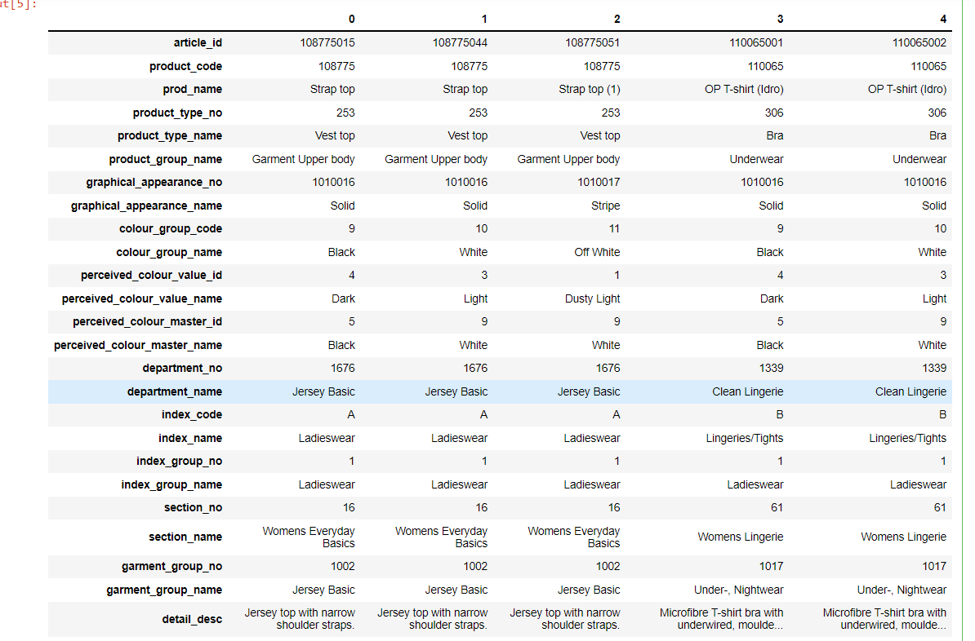
Articles File
Notes:
detailed metadata for each article_id available for purchase

Slide 34
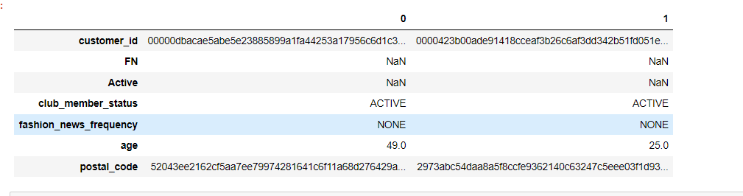
Customers File
Notes:
metadata for each customer_id in dataset

Slide 35
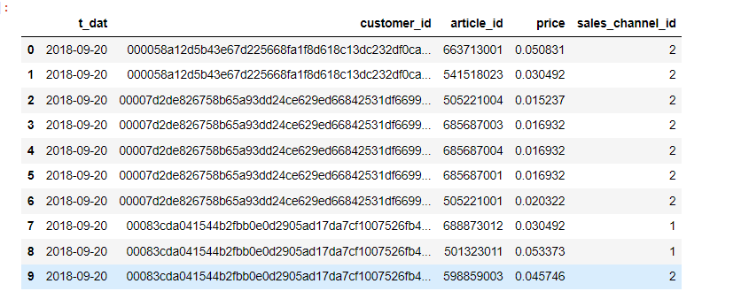
Transactions File
Notes:
the training data, consisting of the purchases each customer for each date, as well as additional information. Duplicate rows correspond to multiple purchases of the same item.

Slide 36
Exploration and Visualization

Slide 37
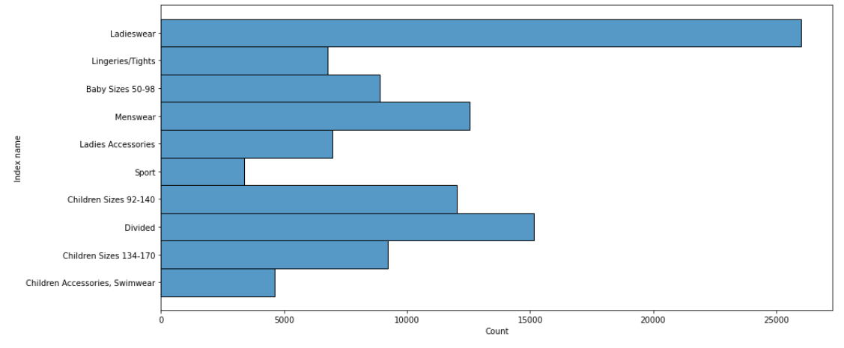
Articles Index name Count
Articles with the Index Name Ladieswear have the highest count

Slide 38
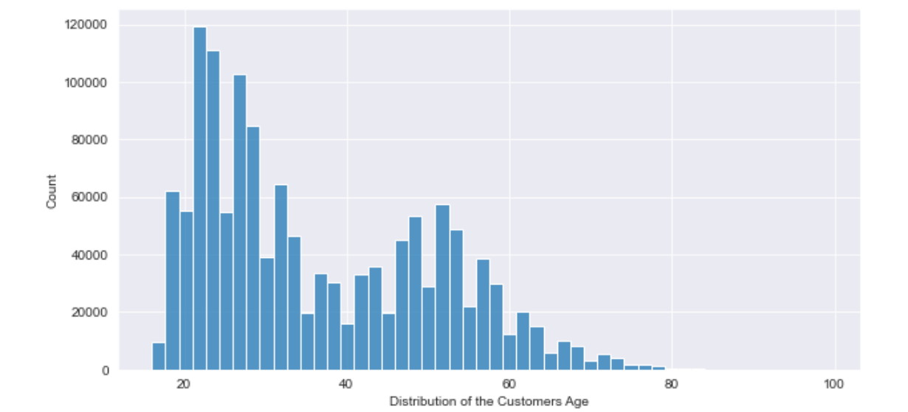
Distribution of Age of Customers
The number of customers in the Age Range 25-35 are very high

Slide 39
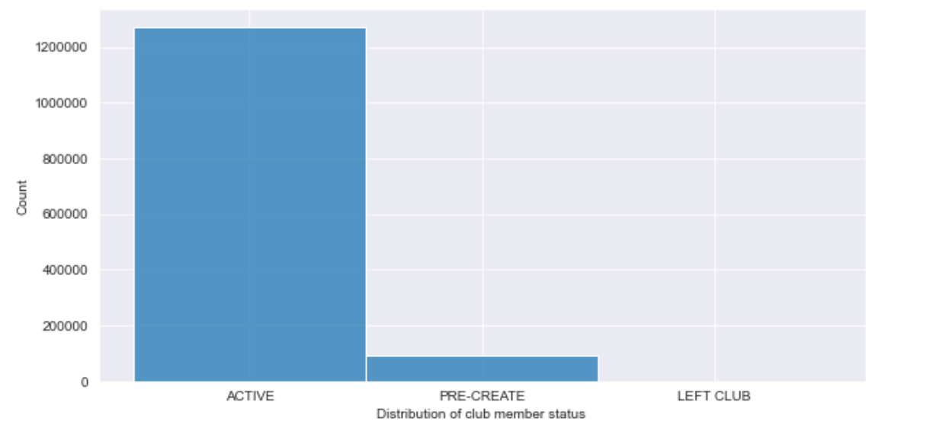
Club Member Status Count
There are over one million Active Customers

Slide 40
Preprocessing

Slide 41
Preprocessing Steps
Combined all the text data of articles including description into a new column called text
Preprocessed the text column
Removing stopwords
Removing punctuations
Performed Lemmatization
Converted preprocessed words into vector form using TF-IDF

Slide 42
Preprocessing Steps
Merged the article table with the transactions table
Grouped the customer’s id with the text details of the articles they have bought

Slide 43
Calculating Similarity

Slide 44
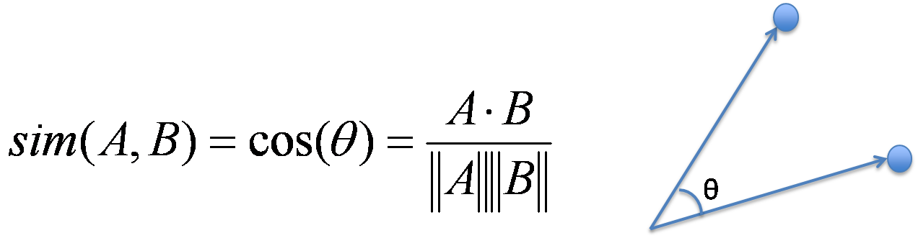
Cosine Similarity
Cosine Similarity measures the similarity between two vectors of an inner product space
Calculated cosine similarity between the User bought articles and the Article TF-IDF
Based on the scores derived from cosine similarity, generated the recommendations.

Slide 45
Results

Slide 46
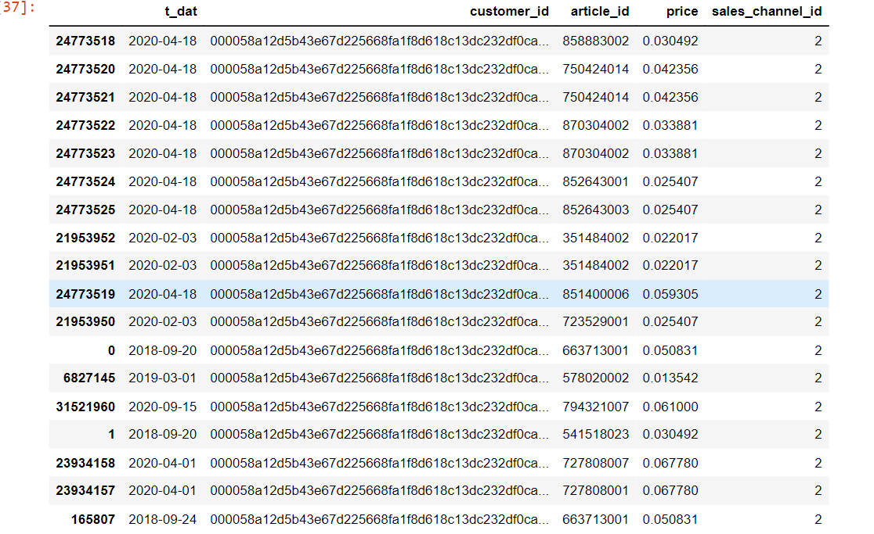
Transactions for one particular Customer ID

Slide 47
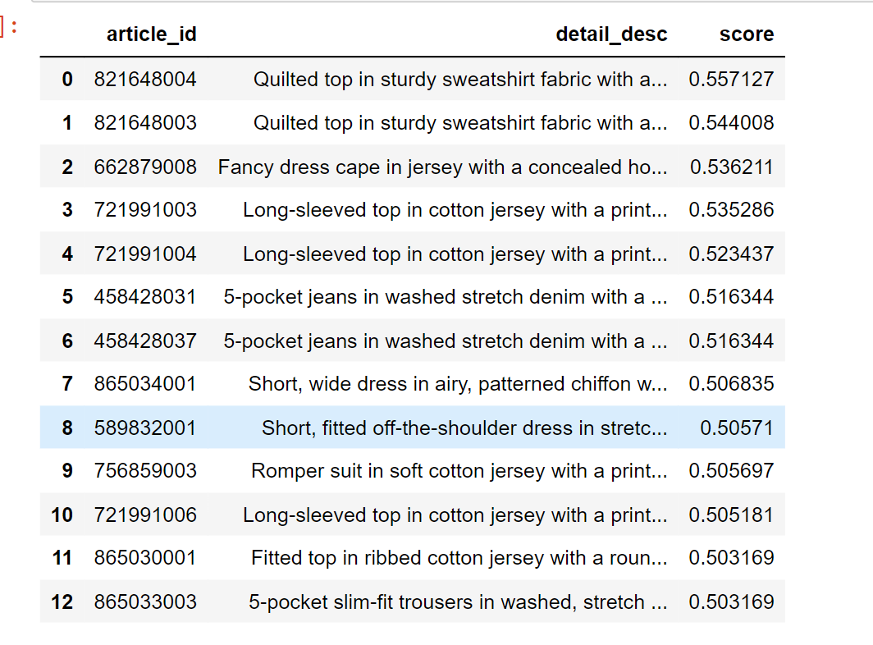
Results
Top 12 Recommendations for one customer

Slide 48
Future Work

Slide 49
Future Work
Use BERT Embeddings and calculate Cosine Similarity based on it
Explore Collaborative Filtering and Hybrid Techniques to generate better recommendations

Slide 50
Questions?

Slide 51
Thank You!

